Slide 1

UNIT-1 INTRODUCTION TO RESEARCH

Slide 2
MEANING OF RESEARCH
Research in general refers to….
A search for knowledge.
A scientific and systematic search for relevant information on a specific topic.
Research is an art of scientific investigation.
Research is a careful investigation or inquiry especially through search for new facts in any branch of knowledge

Slide 3
DEFINITIONS
Research as a “systematized effort to gain new knowledge.”
- Redman and Mory
2. Research comprises defining and redefining problems, formulating hypothesis or suggested solutions; collecting, organizing and evaluating data; making deductions and reaching conclusions; and at last carefully testing the conclusions to determine whether they fit the formulating hypothesis
- “Clifford Woody”

Slide 4
OBJECTIVES OF RESEARCH
The purpose of research is to discover answers through the application of scientific procedures.
The main aim of research is to find out the truth which is hidden and which has not been discovered as yet.

Slide 5
Research objectives falling into a number of following broad groupings:
Exploratory or Formulative Research studies: To gain familiarity with a phenomenon (a fact or a situation that is observed)or to achieve new insights into it.
Descriptive Research studies : To potray accurately the characteristics of a particular individual, situation or a group
Diagnostic Research studies: To determine the frequency with which something
occurs or with which it is associated with something else.
Hypothesis-Testing Research studies: To test a hypothesis of a causal relationship between variables.
HYPOTHESIS: an idea or explanation for something that is based on known facts but has not yet been proved

Slide 6
TYPES OF RESEARCH
Descriptive Vs Analytical research.
Applied vs. Fundamental.
Quantitative vs. Qualitative
Conceptual vs. Empirical
Some other types of research

Slide 7
1. Descriptive Vs Analytical research.
Descriptive research:
Includes surveys and fact-finding enquiries of different kinds.
The major purpose of descriptive research is description of the state of affairs as it exists
at present.
The main characteristic of this method is that the researcher has no control over the variables; he can only report what has happened or what is happening.
Researchers discover causes even when they cannot control the variables.
The methods of research utilized in descriptive research are survey methods of all kinds,
including comparative and correlational methods.
Analytical research:
The researcher has to use facts or information already available, and analyze these to make a critical evaluation of the material.

Slide 8
2. Applied vs. Fundamental.
Applied research:
Aims at finding a solution for an immediate problem facing a society or an industrial/business organization.
The central aim of applied research is to discover a solution for some pressing practical problem.
Example for Applied research.
Research aimed at certain conclusions (say, a solution) facing a concrete social or business problem.
Research to identify social, economic or political trends that may affect a particular institution or the copy research or the marketing research or evaluation research.
Fundamental research:
is mainly concerned with generalizations and with the formulation of a theory.
Fundamental research is directed towards finding information that has a broad base of applications
Examples of fundamental research:
Research concerning some natural phenomenon or relating to pure mathematics.
Research carried on with a view to make generalizations about human behavior.

Slide 9
3. Quantitative vs. Qualitative:
Quantitative research:
is based on the measurement of quantity or amount.
It is applicable to phenomena that can be expressed in terms of quantity.
Quantitative Research is used to quantify the problem by way of generating numerical data or data that can be transformed into usable statistics.
It is used to quantify attitudes, opinions, behaviors, and other defined variables – and generalize results from a larger
sample population.
Quantitative Research uses measurable data to formulate facts and uncover patterns in research.
Quantitative data collection methods are much more structured than Qualitative data collection methods.
Quantitative data collection methods include various forms of surveys – online surveys, paper surveys, mobile surveys and kiosk surveys, face-to-face interviews, telephone interviews, longitudinal studies, website interceptors, online polls, and systematic observations.

Slide 10
Qualitative research:
is concerned with qualitative phenomenon.
Phenomena relating to or involving quality or kind.
Qualitative Research is primarily exploratory research.
It is used to gain an understanding of underlying reasons, opinions, and motivations.
It provides insights into the problem or helps to develop ideas or hypotheses for potential quantitative research.
Qualitative Research is also used to uncover trends in thought and opinions, and dive deeper into the problem.
Qualitative data collection methods vary using unstructured or semi-structured techniques.
Some common methods include focus groups (group discussions), individual interviews, and participation/observations.
The sample size is typically small, and respondents are selected to fulfill a given quota.

Slide 11
4. Conceptual vs. Empirical:
Conceptual research:
is that related to some abstract idea(s) or theory.
It is generally used by philosophers and thinkers to develop new concepts or to reinterpret existing ones.
Empirical research:
relies on experience or observation alone, often without due regard for system and theory.
It is data-based research, coming up with conclusions which are capable of being verified by observation or experiment.
We can also call it as experimental type of research.
In such a research it is necessary to get at facts firsthand, at their source, and actively to go about doing certain things to stimulate the production of desired information.
In such a research, the researcher must first provide himself with a working hypothesis or guess as to the probable results.
He then works to get enough facts (data) to prove or disprove his hypothesis.
He then sets up experimental designs which he thinks will manipulate the persons or the materials concerned so as to bring forth the desired information.
Evidence gathered through experiments or empirical studies is today considered to be the most powerful support possible for a given hypothesis.

Slide 12
Some other types of research
Diagnostic Research: It is also called clinical research which aims at identifying the causes of a problem, frequency with which it occur and the possible solutions for it.
Historical Research: It is the study of past records and other information sources, with a view to find the origin and development of a phenomenon and to discover the trends in the past, in order to understand the present and to anticipate the future.

Slide 13
Significance of Research
It promotes the development of logical habits of thinking and organisation
Research provides the basis for nearly all government policies in our economic system.
Research has its special significance in solving various operational and planning problems of business and industry.
Research is equally important for social scientists in studying social relationships and in seeking answers to various social problems.

Slide 14
In addition to what has been stated above, the significance of research can also be understood keeping in view the following points:
(a) To those students who are to write a master’s or Ph.D. thesis, research may mean a careerism or a way to attain a high position in the social structure;
(b) To professionals in research methodology, research may mean a source of livelihood;
(c) To philosophers and thinkers, research may mean the outlet for new ideas and insights;
(d) To literary men and women, research may mean the development of new styles and creative work;
(e) To analysts and intellectuals, research may mean the generalisations of new theories.

Slide 15
Research Methodology
Meaning:
-It is a way to systematically solve the research problem.
- It may be understood as a science of studying how research is done scientifically.

Slide 16
It is necessary for the researcher to know not only the research methods/techniques but also the methodology.
Researchers not only need to know how to develop certain indices or tests, how to calculate the mean, the mode, the median or the standard deviation or chi-square, how to apply particular research techniques, but they also need to know which of these methods or techniques, are relevant and which are not, and what would they mean and indicate and why.
Researchers also need to understand the assumptions underlying various techniques and they need to know the criteria by which they can decide that certain techniques and procedures will be applicable to certain problems and others will not.

Slide 17
For example,
an architect, who designs a building, has to consciously evaluate the basis of his decisions, i.e., he has to evaluate why and on what basis he selects particular size, number and location of doors, windows and ventilators, uses particular materials and not others and the like.
Similarly, in research the scientist has to expose the research decisions to evaluation before they are implemented

Slide 18
Thus, when we talk of research methodology we not only talk of the research methods but also consider the logic behind the methods we use in the context of our research study and explain why we are using a particular method or technique and why we are not using others so that research results are capable of being evaluated either by the researcher himself or by others.

Slide 19
WHAT IS A RESEARCH PROBLEM?
The term ‘problem’ means a question or issue to be examined.
Research Problem refers to some difficulty/need which a researcher experiences in the context of either theoretical or practical situation and wants to obtain a solution for the same.

Slide 20
How do we know we have a research problem?
Customer complaints
Conversation with company employees
Observation of inappropriate behavior or conditions in the firm
Deviation from the business plan
Success of the firm’s competitor’s
Relevant reading of published material (trends, regulations)
Company records and reports.

Slide 21
Definition of the problem involves two activities:
Identification / Selection of the Problem
Formulation of the Problem

Slide 22
1. Identification/selection of the research problem.
This step involves identification of a few problems and selection of one out of them, after evaluating the alternatives against certain selection criteria.

Slide 23
Definition/formulation of the research problem.
Formulation means translating and transforming the selected research problem/topic/idea into a scientifically researchable question. It is concerned with specifying exactly what the research problem is.
Problem definition or Problem statement is a clear, precise and succinct statement of the question or issue that is to be investigated with the goal of finding an answer or solution.
There are two ways of stating a problem:
Posting question / questions
Making declarative statement / statements

Slide 24
RESEARCH PROCESS
Research process consists of series of actions or steps necessary to effectively carry out research and the desired sequencing of these steps.
The chart shown in Figure well illustrates a research process.

Slide 25
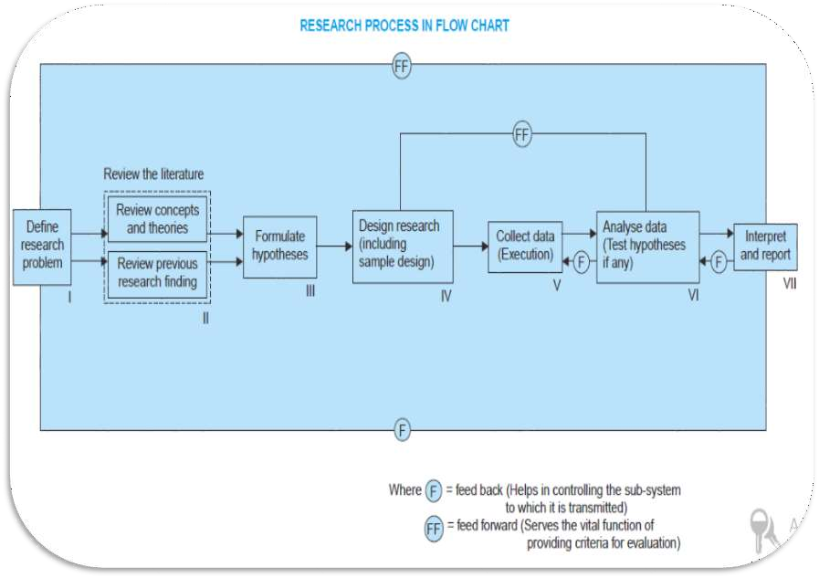

Slide 26
Formulating the research problem
Extensive literature survey
Developing the hypothesis
Preparing the research design
Determining sample design
Collecting the data
Execution of the project
Analysis of data
Hypothesis testing
Generalizations and interpretation
Preparation of the report or presentation of the results

Slide 27
1. Formulating the research problem:
There are two types of research problems, viz., those which relate to states of nature and those which relate to relationships between variables.
Researcher must decide the general area of interest or aspect of a subject-matter that he would like to inquire into

Slide 28
2. Extensive literature survey
Once the problem is formulated, a brief summary of it should be written down.
It is compulsory for a research worker writing a thesis for a Ph.D. degree to write a synopsis of the topic and submit it to the necessary Committee or the Research Board for approval.

Slide 29
3. Development of working hypotheses:
After extensive literature survey, researcher should state in clear terms the working hypothesis or hypotheses.
In most types of research, the development of working hypothesis plays an important role.
Hypothesis should be very specific and limited to the piece of research in hand because it has to be tested.

Slide 30
4. Preparing the research design:
There are several research designs, such as, experimental and non-experimental hypothesis testing.
Experimental designs can be either informal designs
(or)
formal designs , out of which the researcher must select one for his own project.

Slide 31
5. Determining sample design:
The researcher must decide the way of selecting a sample or what is popularly known as the sample design.
Samples can be either probability samples or non-probability samples.

Slide 32
6. Collecting the data:
Primary data can be collected either through experiment or through survey.
In the case of a survey, data can be collected by any one or more of the following ways:
By observation:
Through personal interview:
Through telephone interviews:
By mailing of questionnaires:
Through schedules:

Slide 33
7. Execution of the project:
Execution of the project is a very important step in the research process.
The researcher should see that the project is executed in a systematic manner and in time.
8. Analysis of data: Researcher should classify the raw data into some purposeful and usable categories.

Slide 34
9. Hypothesis-testing:
Various tests, such as Chi square test, t-test, F-test, have been developed by statisticians for the purpose.
The hypotheses may be tested through the use of one or more of such tests, depending upon the nature and object of research inquiry
Hypothesis-testing will result in either accepting the hypothesis or in rejecting it.

Slide 35
10. Generalisations and interpretation:
: If a hypothesis is tested and upheld several times, it may be possible for the researcher to arrive at generalisation, i.e., to build a theory. As a matter of fact, the real value of research lies in its ability to arrive at certain generalisations.
If the researcher had no hypothesis to start with, he might seek to explain his findings on the basis of some theory. It is known as interpretation.

Slide 36
11. Preparation of the report or the thesis:
Finally, the researcher has to prepare the report of what has been done by him. Writing of report must be done with great care keeping in view the following:
1. The layout of the report should be as follows:
(i) the preliminary pages;
(ii) the main text, and
(iii) the end matter.
Towards the end of the main text, researcher should again put down the results of his research clearly and precisely. In fact, it is the final summing up.

Slide 37
In its preliminary pages the report should carry title and date followed by acknowledgements and foreword. Then there should be a table of contents followed by a list of tables and list of graphs and charts, if any, given in the report.

Slide 38
The main text of the report should have the following parts:
(a) Introduction: It should contain a clear statement of the objective of the research and an explanation of the methodology adopted in accomplishing the research. The scope of the study along with various limitations should as well be stated in this part.
(b) Summary of findings: After introduction there would appear a statement of findings and recommendations in non-technical language. If the findings are extensive, they should be summarised. (c) Main report:
The main body of the report should be presented in logical sequence and broken-down into readily identifiable sections.
(d) Conclusion:

Slide 39
At the end of the report, appendices should be enlisted in respect of all technical data. Bibliography, i.e., list of books, journals, reports, etc., consulted, should also be given in the end. Index should also be given specially in a published research report.

Slide 40
Criteria of Good Research
The scientific research must satisfy the following criteria:
The purpose of the research should be clearly defined and common concepts be used.
The research procedure used should be described in sufficient detail to permit another researcher to repeat the research for further advancement, keeping the continuity of what has already been attained.
The procedural design of the research should be carefully planned to yield results that are as objective as possible.
The researcher should report with complete frankness, flaws in procedural design and estimate their effects upon the findings.
The analysis of data should be sufficiently adequate to reveal its significance and the methods of analysis used should be appropriate. The validity and reliability of the data should be checked carefully.
Conclusions should be confined to those justified by the data of the research and limited to those for which the data provide an adequate basis.
Greater confidence in research is warranted if the researcher is experienced, has a good reputation in research and is a person of integrity.

Slide 41
Research Design
Research design is the conceptual structure within which research is conducted;
it constitutes the blueprint for the collection, measurement and analysis of data.

Slide 42
The design decisions happen to be in respect of:
(i) What is the study about?
(ii) Why is the study being made?
(iii) Where will the study be carried out?
(iv) What type of data is required?
(v) Where can the required data be found?
(vi) What periods of time will the study include?
(vii) What will be the sample design?
(viii) What techniques of data collection will be used?
(ix) How will the data be analysed?
(x) In what style will the report be prepared?

Slide 43
NEED FOR RESEARCH DESIGN
Research design is needed because it facilitates the smooth sailing of the various research operations, thereby making research as efficient as possible yielding maximal information with minimal expenditure of effort, time and money.
Research design stands for advance planning of the methods to be adopted for collecting the relevant data and the techniques to be used in their analysis, keeping in view the objective of the research and the availability of staff, time and money

Slide 44


